Slide 1

Big Mountain Resort
Scott Sigmund

Slide 2
Problem Identification
Big Mountain Resort uses market average pricing in set their ticket prices
Need to identify a more accurate way to set prices for their tickets by comparing features of nation-wide resorts and prices.

Slide 3
Recommendations
Our recommendation is to set the ticket price between $85.48 and $95.87 based off our model because that covers the absolute error.
This is an increase of at least $4.48 which would be equivalent to $7.8m in yearly revenue.

Slide 4
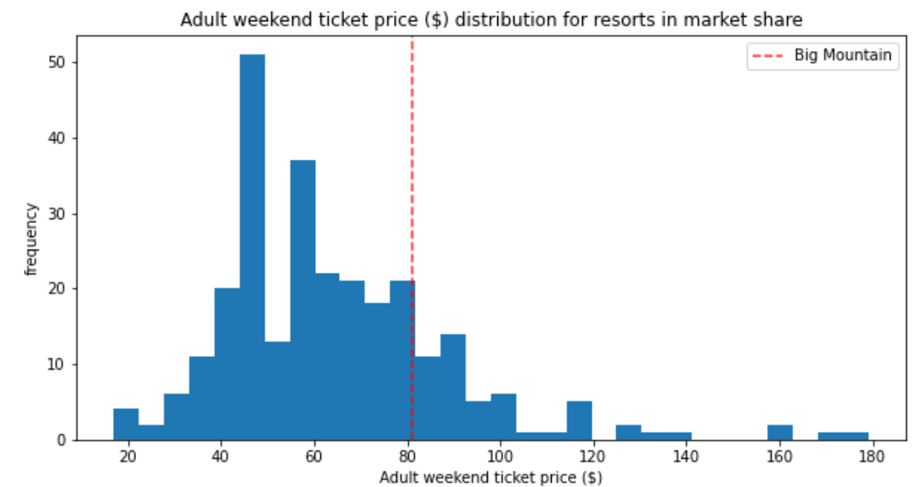
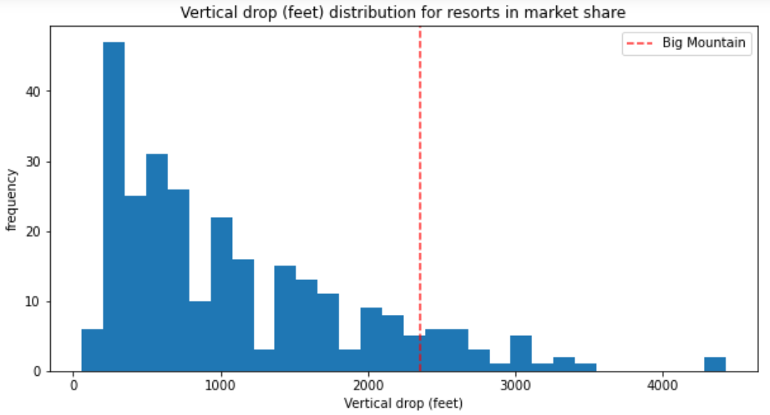
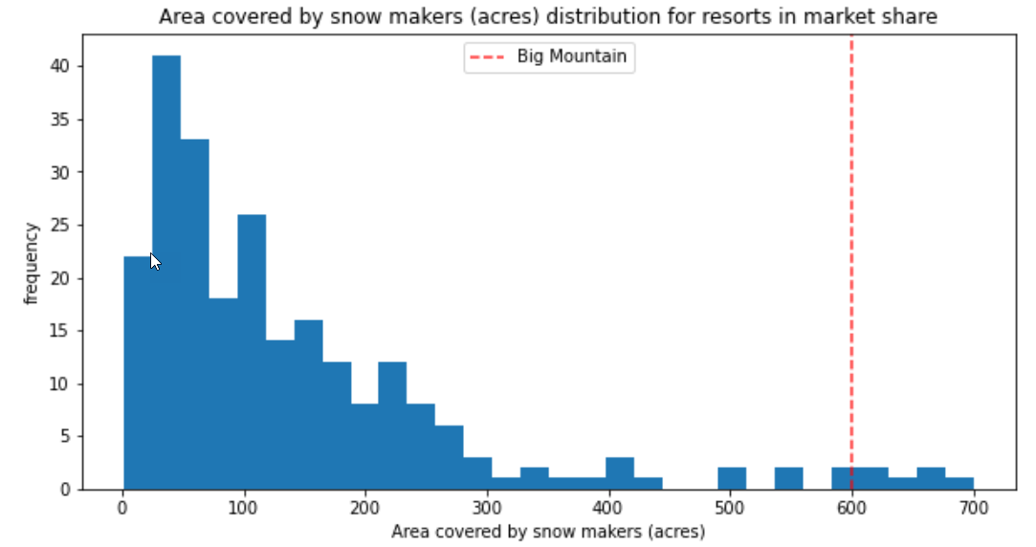
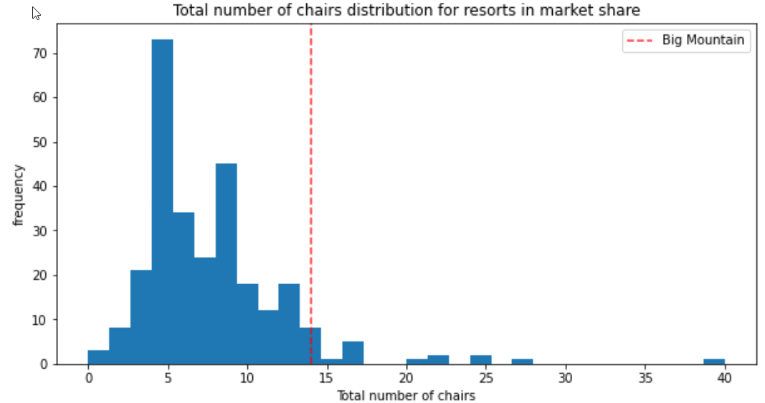
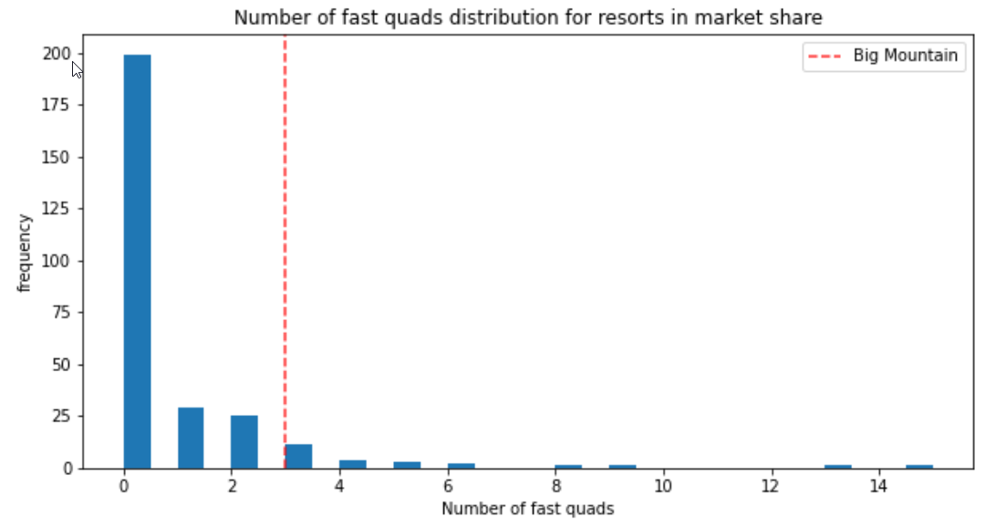
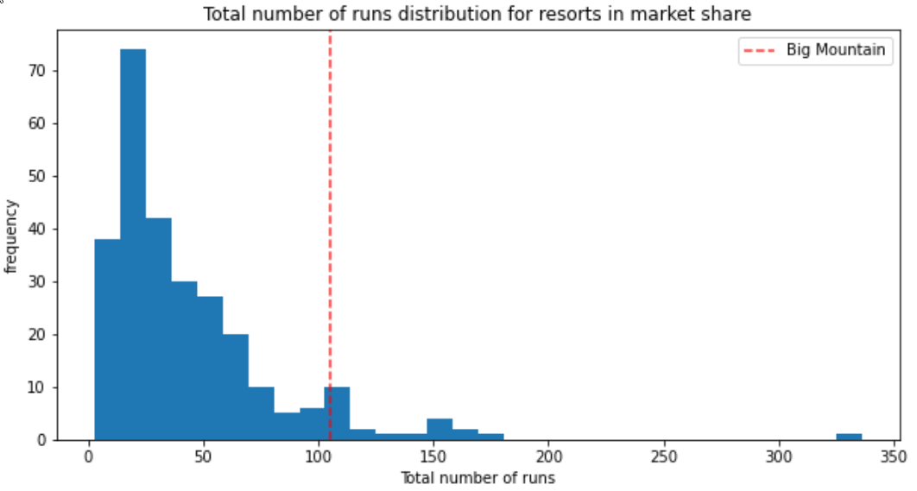
Modeling Result

Slide 5
Modeling Result cont.
Business options:
1. Permanently closing down up to 10 of the least used runs.
2. Increase the vertical drop by adding a run to a point 150 feet lower down but requiring the installation of an additional chair lift to bring skiers back up, without additional snow making coverage
3. Same as 2 but adding 2 acres of snow making cover
4. Increase the longest run by 0.2 mile to boast 3.5 miles length, requiring an additional snow making coverage of 4 acres

Slide 6
Modeling Result cont.
Our findings in for these options:
1. Closing 1 run has no effect on the price or revenue, however closing anymore and the business will need to compare the amount of operational costs decreases and the decrease in revenue to see if the closures are worth the revenue loss.
2. Using predict increase method supports a price increase of $1.99 for this outcome which would result in about $3474638 increase in yearly revenue
3. Adding an additional 2 acres did not increase the amount charged for tickets
4. Increasing the longest run by .2 miles and 4 acres of snow making machines does not increase the price either.

Slide 7
Conclusion
Our conclusion based off our modeling is that the company has a strong case to increase the ticket price by an extra $1.99 after increasing the vertical drop by adding a run to a point 150 feet lower down but requiring the installation of an additional chair lift to bring skiers back up.
This would increase revenue by an extra $3.4m annually and offset the $1.4m operational cost of a new chair lift.

